Slide 1
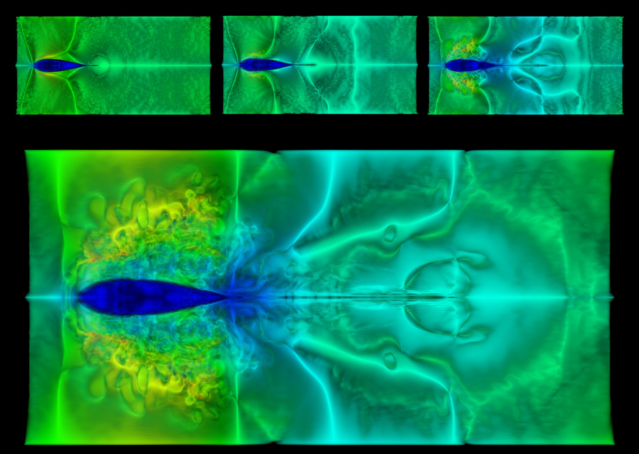
PHYS 8750 Numerical Fluid Dynamics
Fall, 2020
Breaking waves • simulation by D. Dommermuth • TACC vis gallery

Slide 2
PHYS 8750
Outline
Atmospheric Models
Model types
Empirical models/Physics models
Data assimilative models
3. NRLMSIS and IRI
4. GSWM and CTMT
5. Physics models
TIEGCM (difference scheme)
CESM (piecewise finite volume method)
6. Model run and supercomputing
Class # 20
Atmospheric
Models and Community Models
Class #18, 19
Atmospheric
Models

Slide 3
Atmospheric Models
Empirical Models (data based, mathematical, statistical)
Good for climatology and background atmosphere
NRLMSIS, IRI, HWM
Physics Models (physical models)
Steady-state (external forcing or boundary condition)
GSWM, CTMT, Stationary Planetary Waves (week of Nov 17, 19)
Time-evolving (initial condition)
General circulation models (TIEGCM, CESM, KMCM, CTIPe)
Barotropic/baroclinic planetary wave model (week of Nov 17, 19)
Gravity wave models (MAGIC)
Data Assimilative Models
Underlying Physics models + data assimilation
WACCM-DART, ECMWF, MERRA

Slide 4
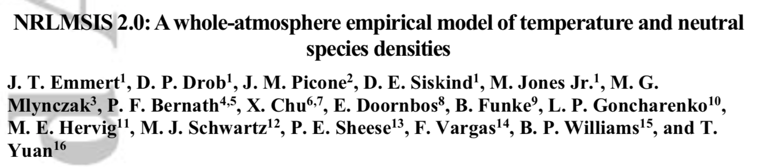
NRLMSIS
Naval Research Lab Mass Spectrometer Incoherent Scatter Model
NRLMSIS 2.0 is an empirical atmospheric model that extends from the ground to the exobase and describes the average observed behavior of temperature, 8 species densities, and mass density via a parametric analytic formulation. The model inputs are location, day of year, time of day, solar activity, and geomagnetic activity.

Slide 5
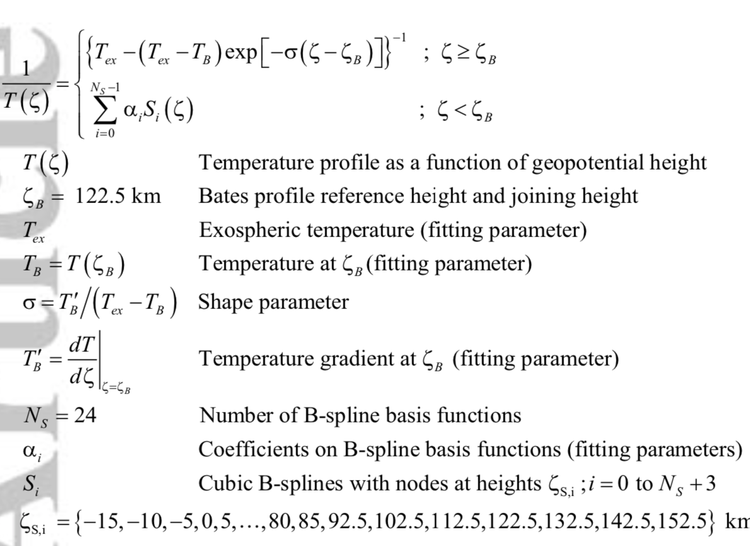
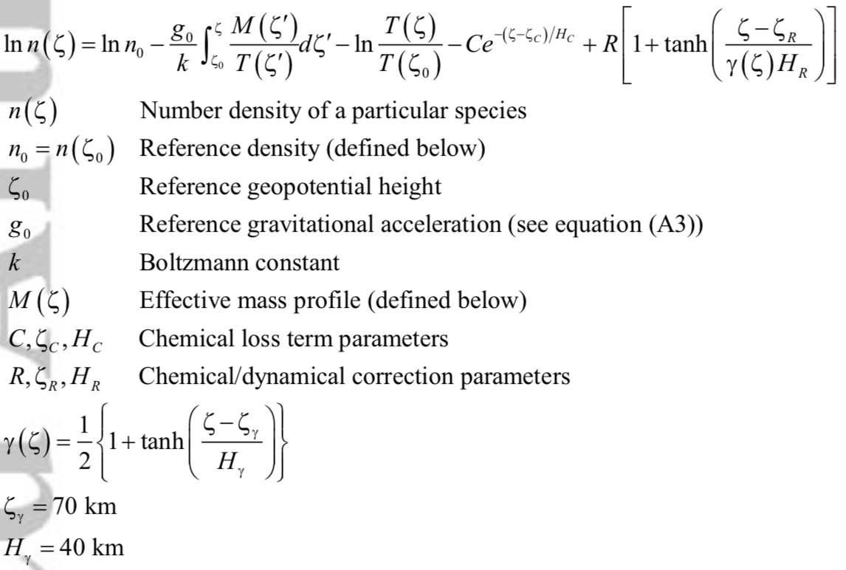
NRLMSIS
parametric analytic formulation + Fitting Using Data

Slide 6
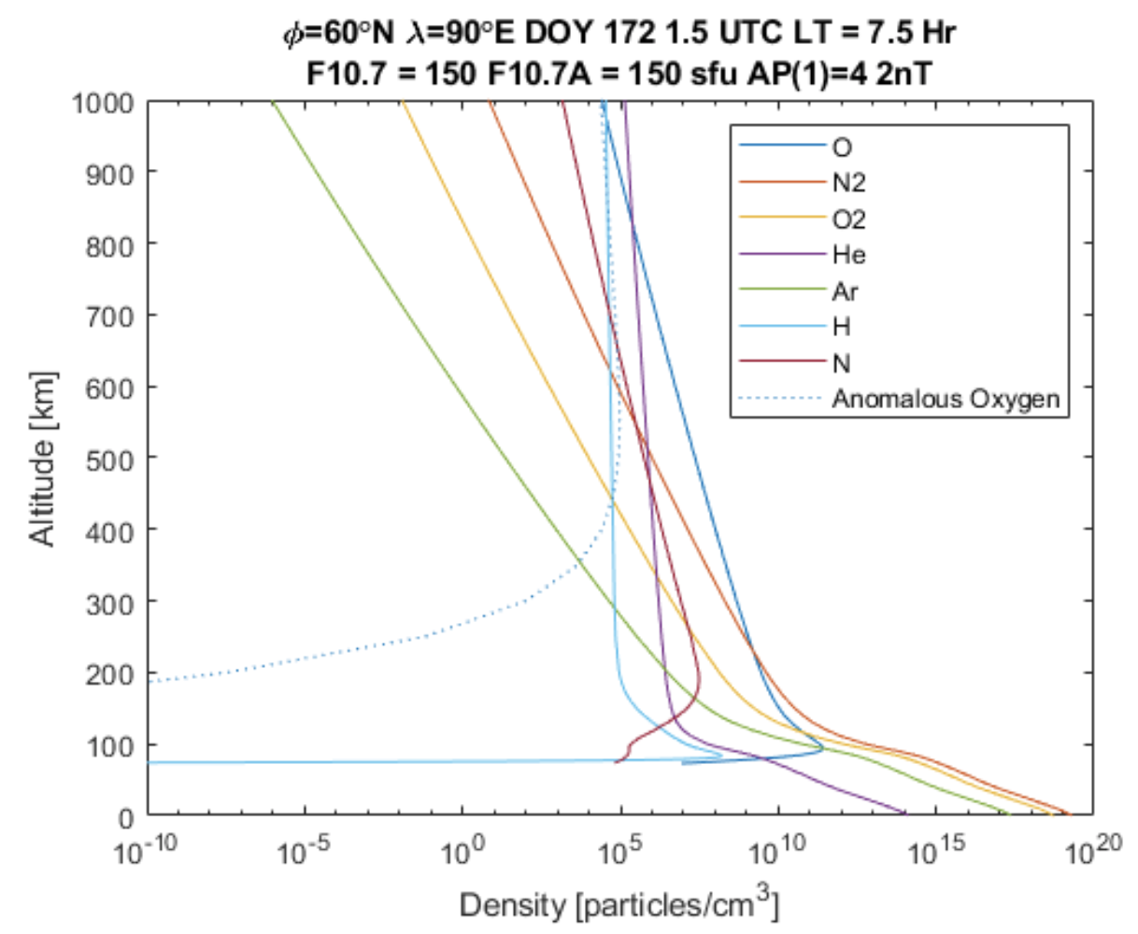
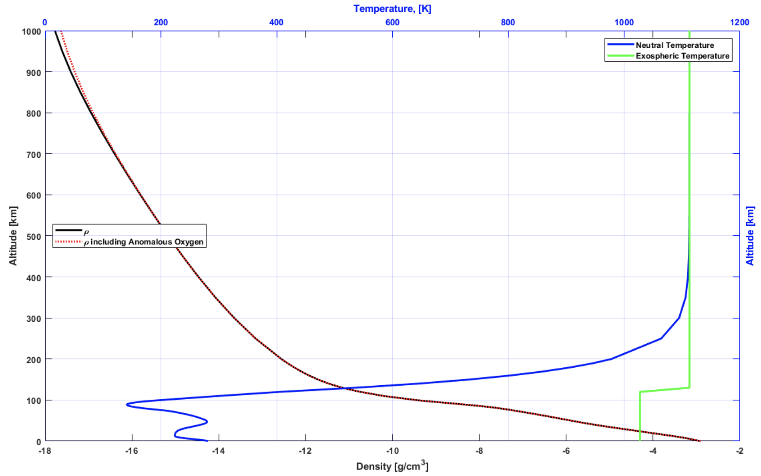
Outputs of NRLMSIS
Density of Species
Density & Temperature

Slide 7
IRI (International Reference Ionosphere)
The International Reference Ionosphere (IRI) is an international project sponsored by the Committee on Space Research (COSPAR) and the International Union of Radio Science (URSI).
PARAMETERS: Ne, Te, Ti, ion composition (O⁺, H⁺, He⁺, N⁺, NO⁺, O⁺₂, Cluster ions), equatorial VI, vertical TEC (vTEC), spread-F probability, auroral boundaries, effects of ionospheric storms on F and E peak densities.
INPUTS: Required: solar indices (F10.7), ionospheric index (ionosonde-based IG index 12-month running mean), magnetic index (ap).

Slide 8
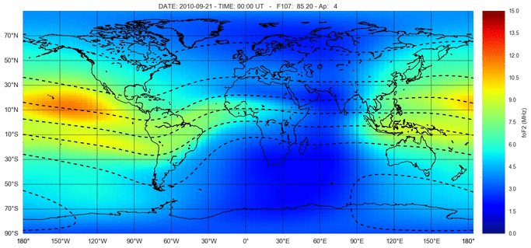
IRI Outputs

Slide 9
Physics Models
Steady-State
Mean values or waves amplitude do not change with time.
Large-scale Wave models
Tides: GSWM, CTMT
Planetary Waves: stationary wave model

Slide 10
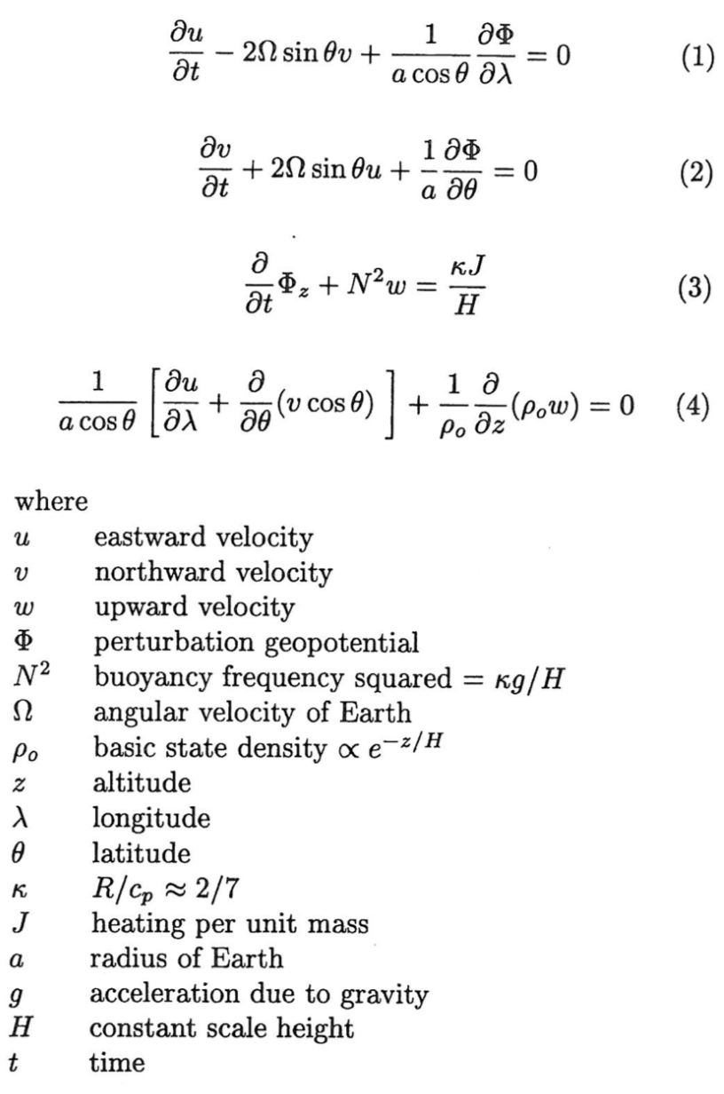
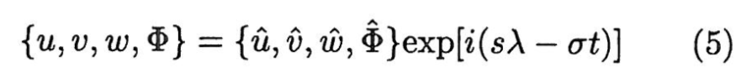
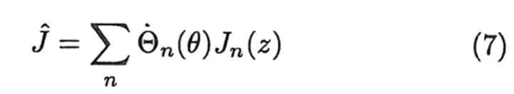
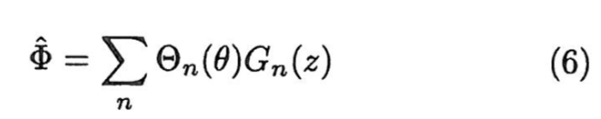
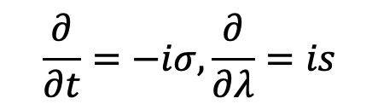
Global Scale Wave Model
By assuming the wave form
Then 4D problem becomes 2D
$$\frac{∂}{∂t}=−iσ,\frac{∂}{∂λ}=is$$
Separation of variable and solve for latitude and altitude directions
Forbes, 1995

Slide 11
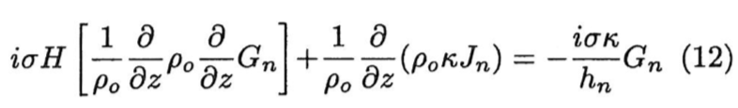
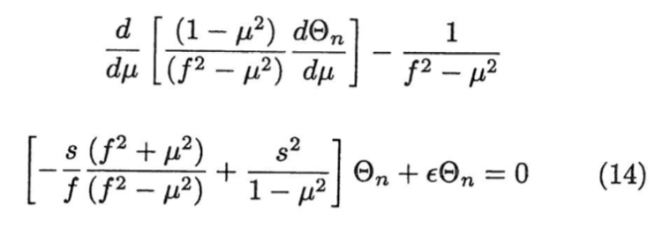
Global Scale Wave Model
Equation along altitude (z direction)
Equation along latitude (y direction)
For each tidal component, decompose heating term into different Hough modes, and solve for the tidal responses in different modes. The full solution is the superposition of all the Hough modes.

Slide 12
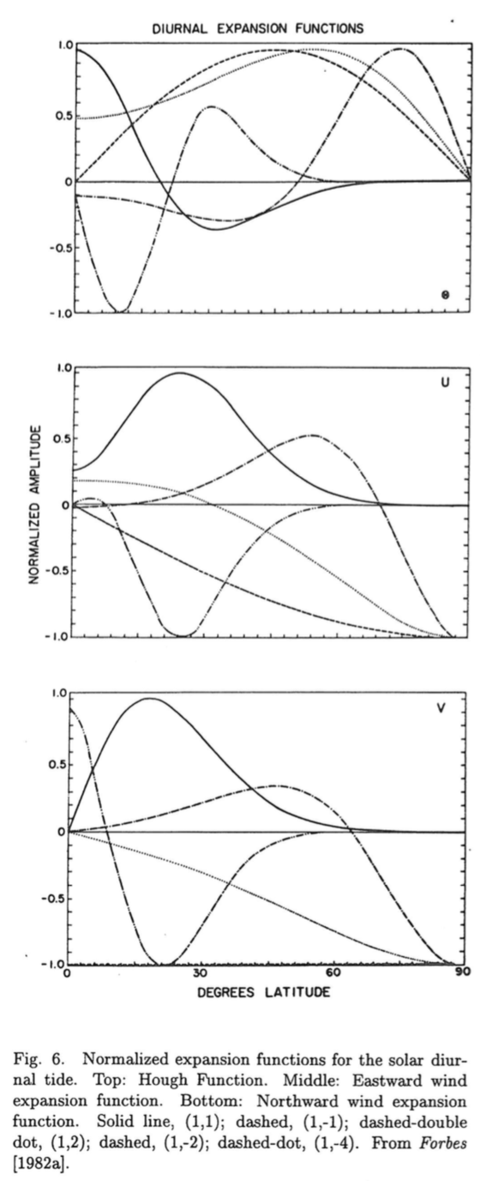
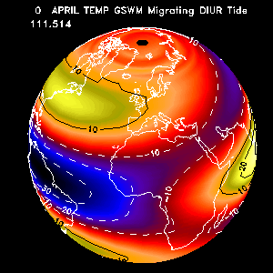
Global Scale Wave Model
Hough Modes
Temperature DW1
Forbes, 1995
Spherical coordinate: Legendre functions

Slide 13
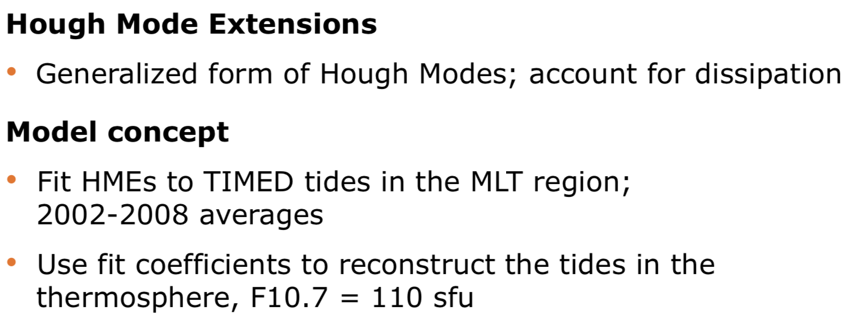
Climatological Tidal Model of the Thermosphere (CTMT)
Oberheide, J., J. M. Forbes, X. Zhang, and S. L. Bruinsma, Climatology of upward propagating diurnal and semidiurnal tides in the thermosphere, J. Geophys. Res., 116, A11306, doi:10.1029/2011JA016784, 2011.

Slide 14
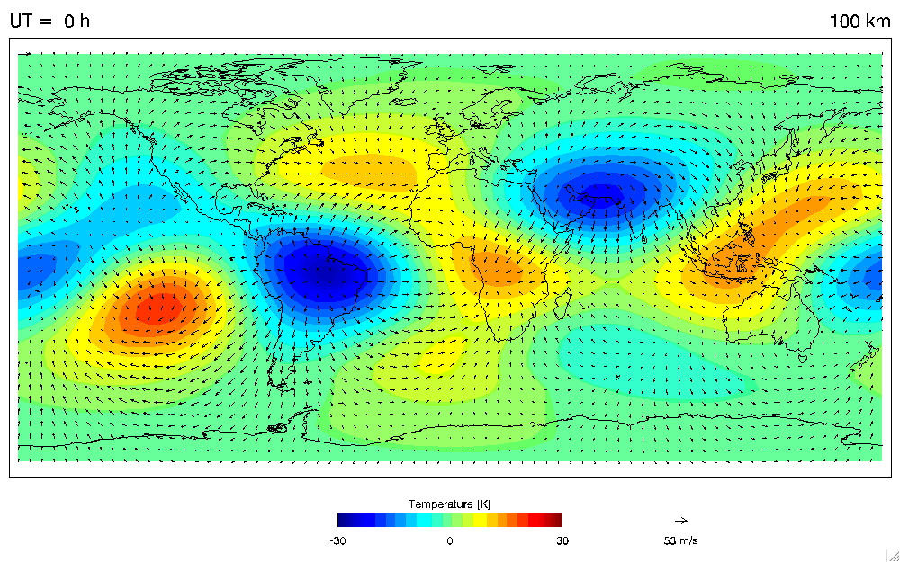
Climatological Tidal Model of the Thermosphere (CTMT)

Slide 15
TIEGCM (Thermosphere Ionosphere Electrodynamics General Circulation Model)

Slide 17
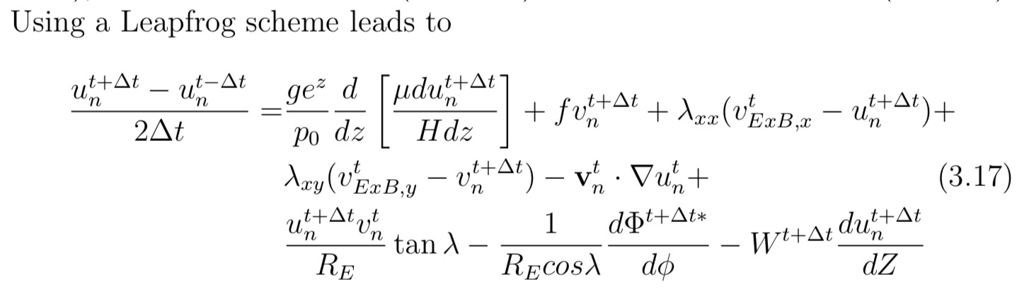
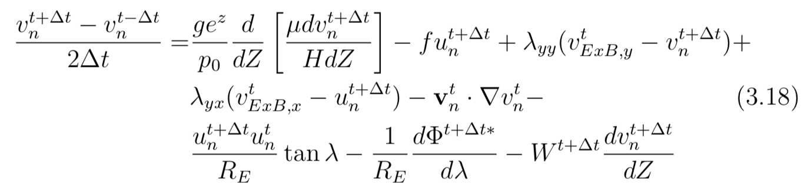
TIEGCM (Numerical Scheme Examples)
Zonal Momentum
Meridional Momentum

Slide 18
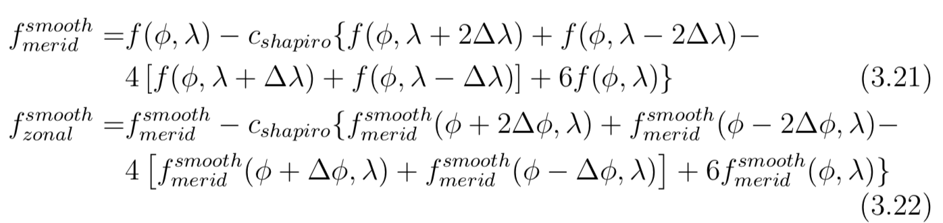
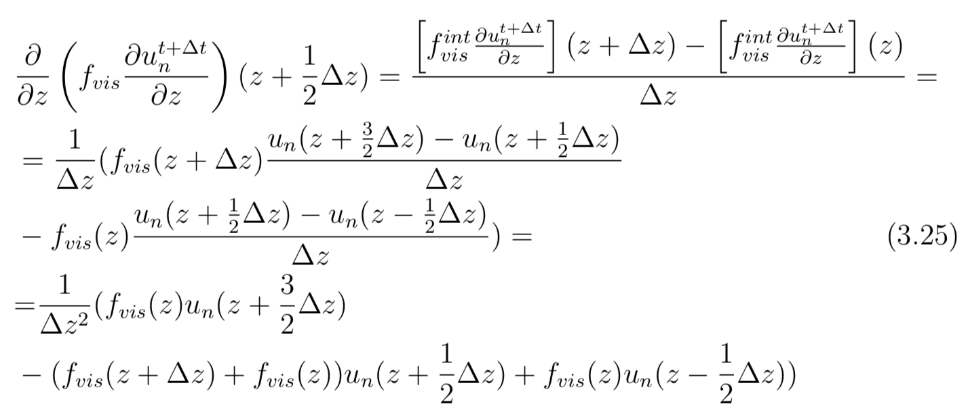
Spatial Filtering (Shapiro constant c = 0.3)
Vertical Direction (Diffusion)

Slide 19
TIEGCM Model Structure

Slide 20
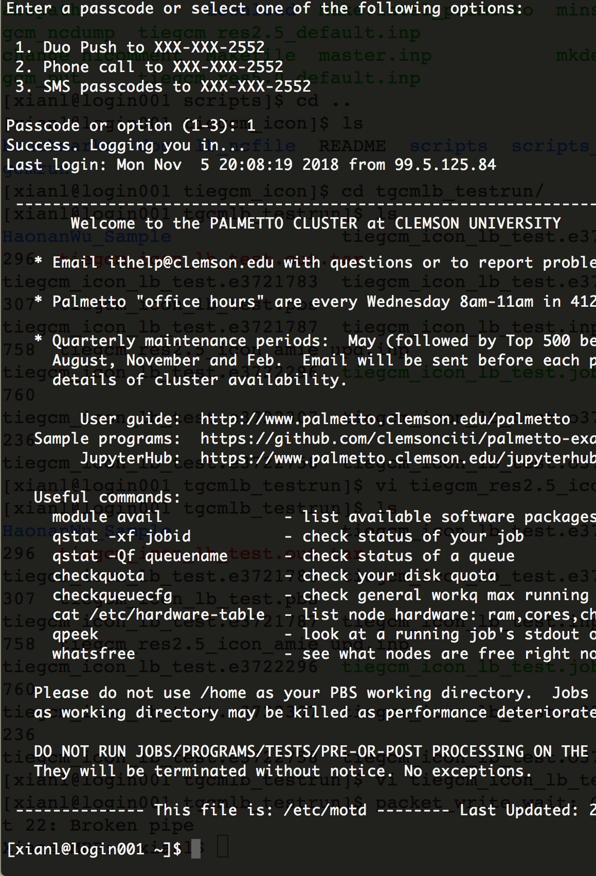
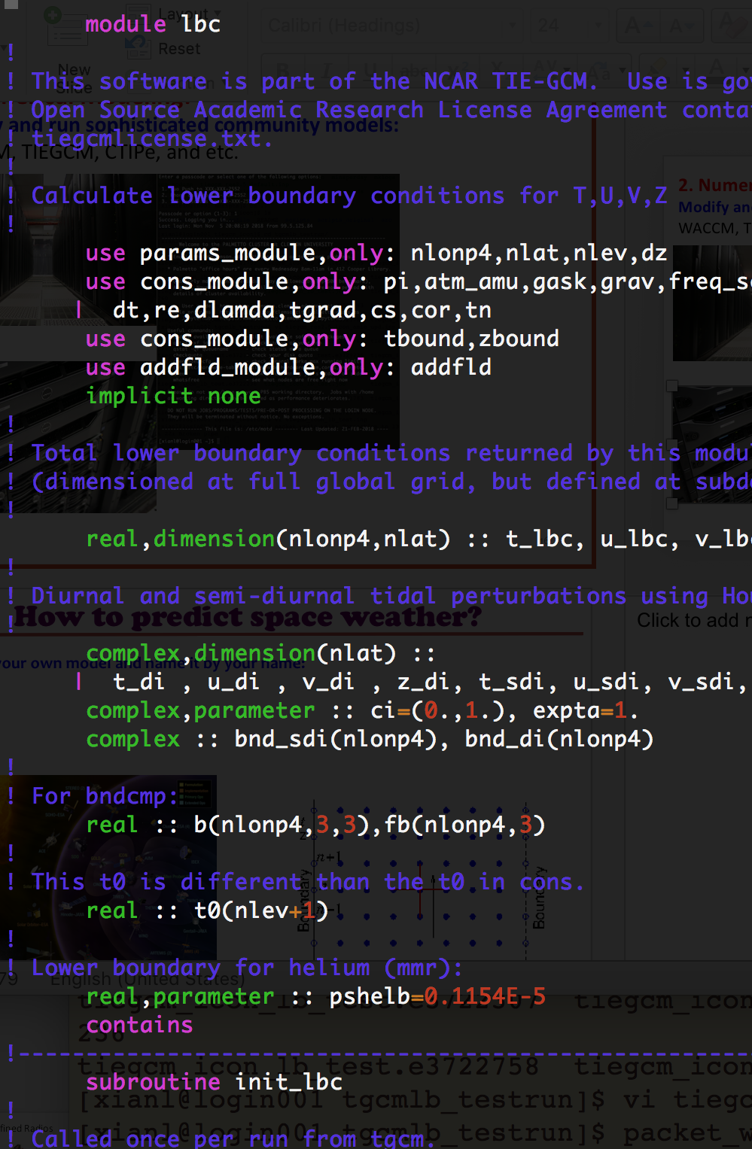
Palmetto Login Page
TIEGCM Code

Slide 21
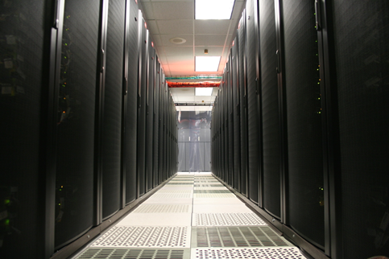

Clemson Palmetto Supercomputer
Community Models:
CESM
WACCM
TIEGCM,
TIMEGCM
Mechanistic Models:
Gravity Wave Planetary Wave

Slide 22
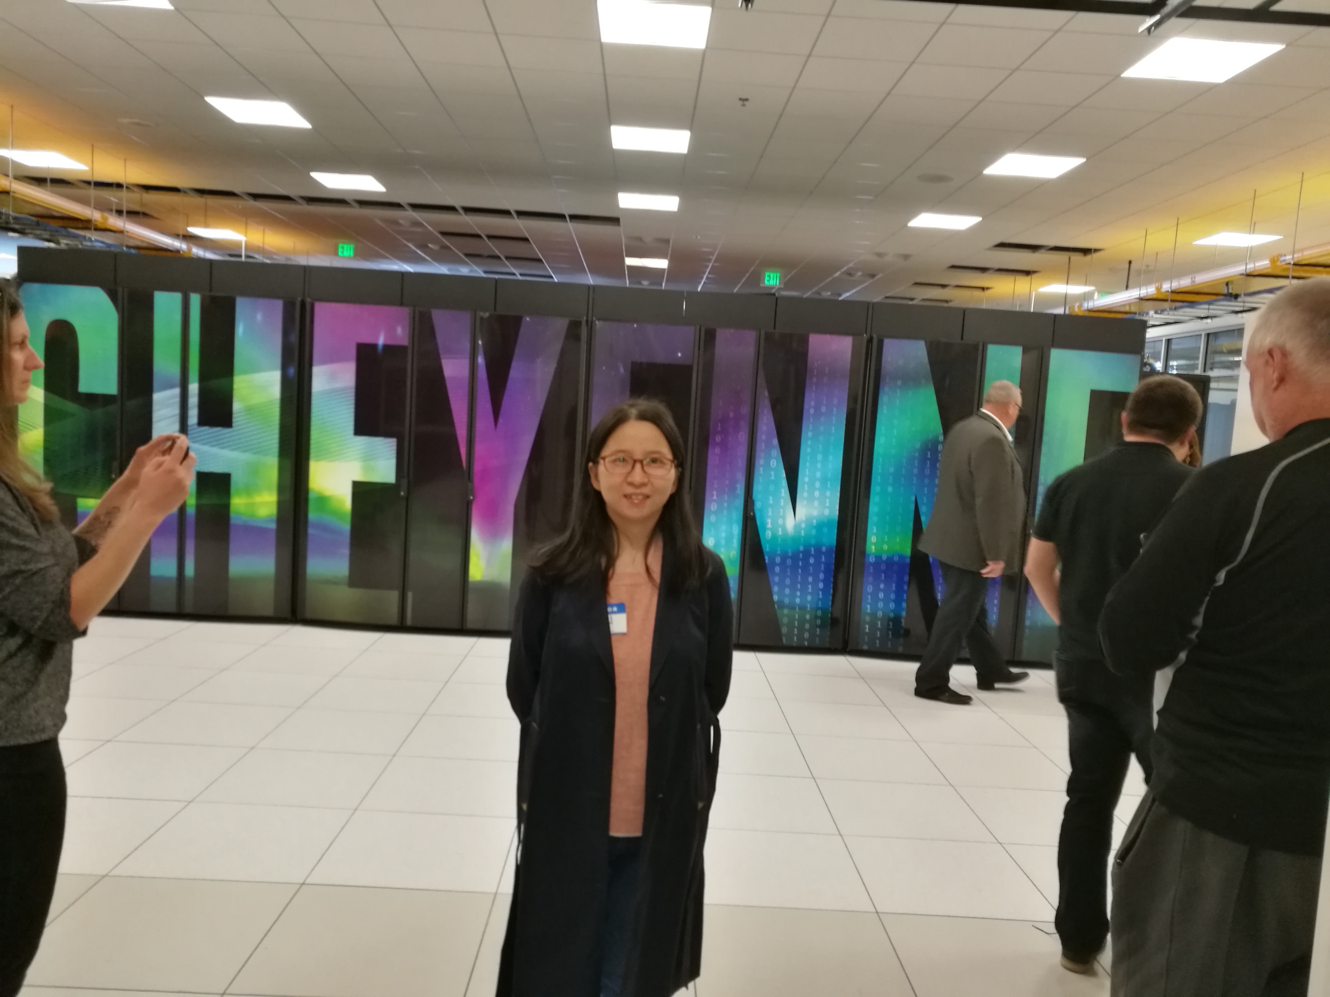
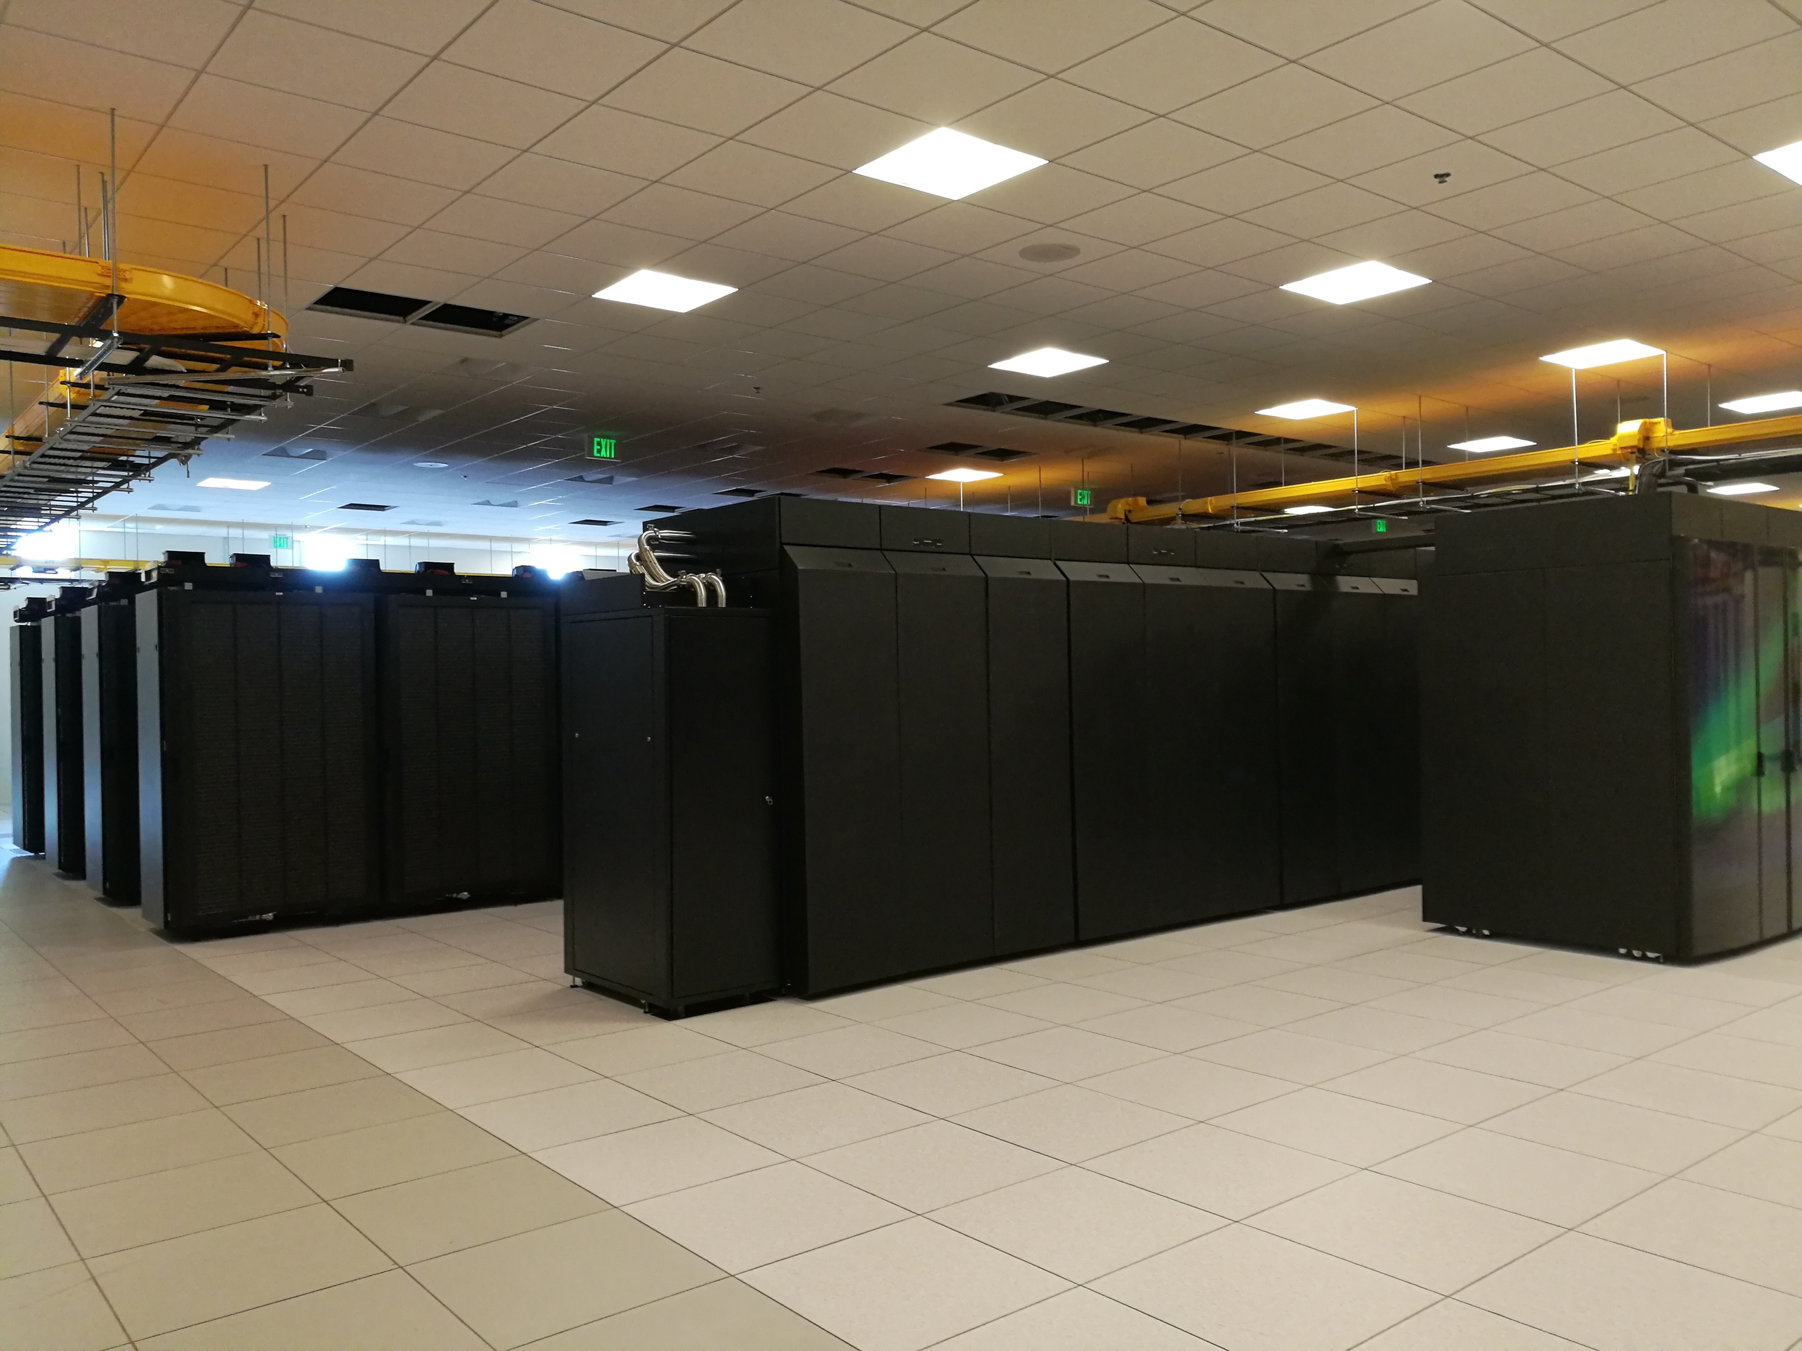
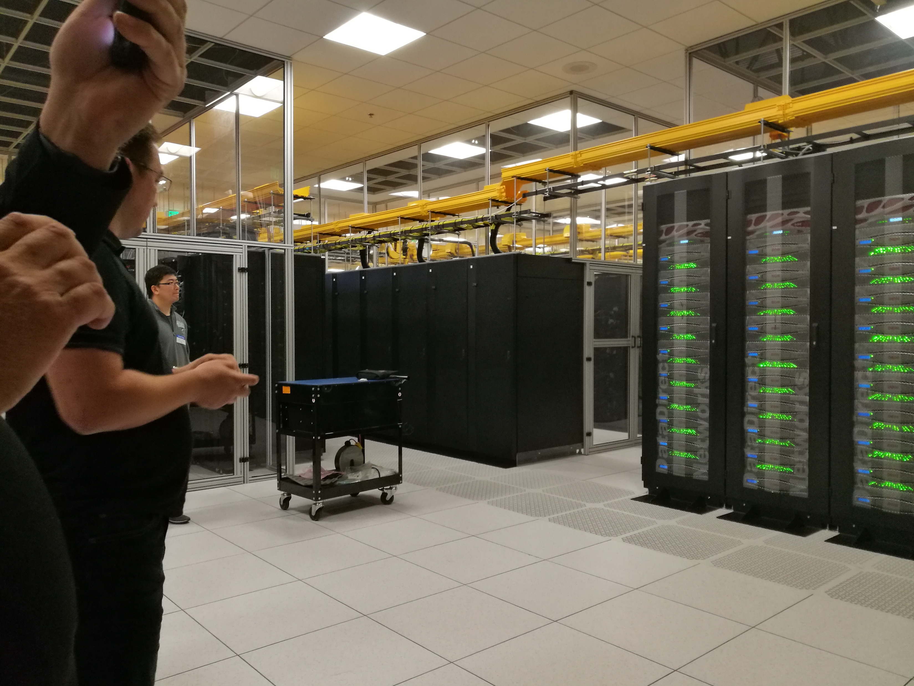
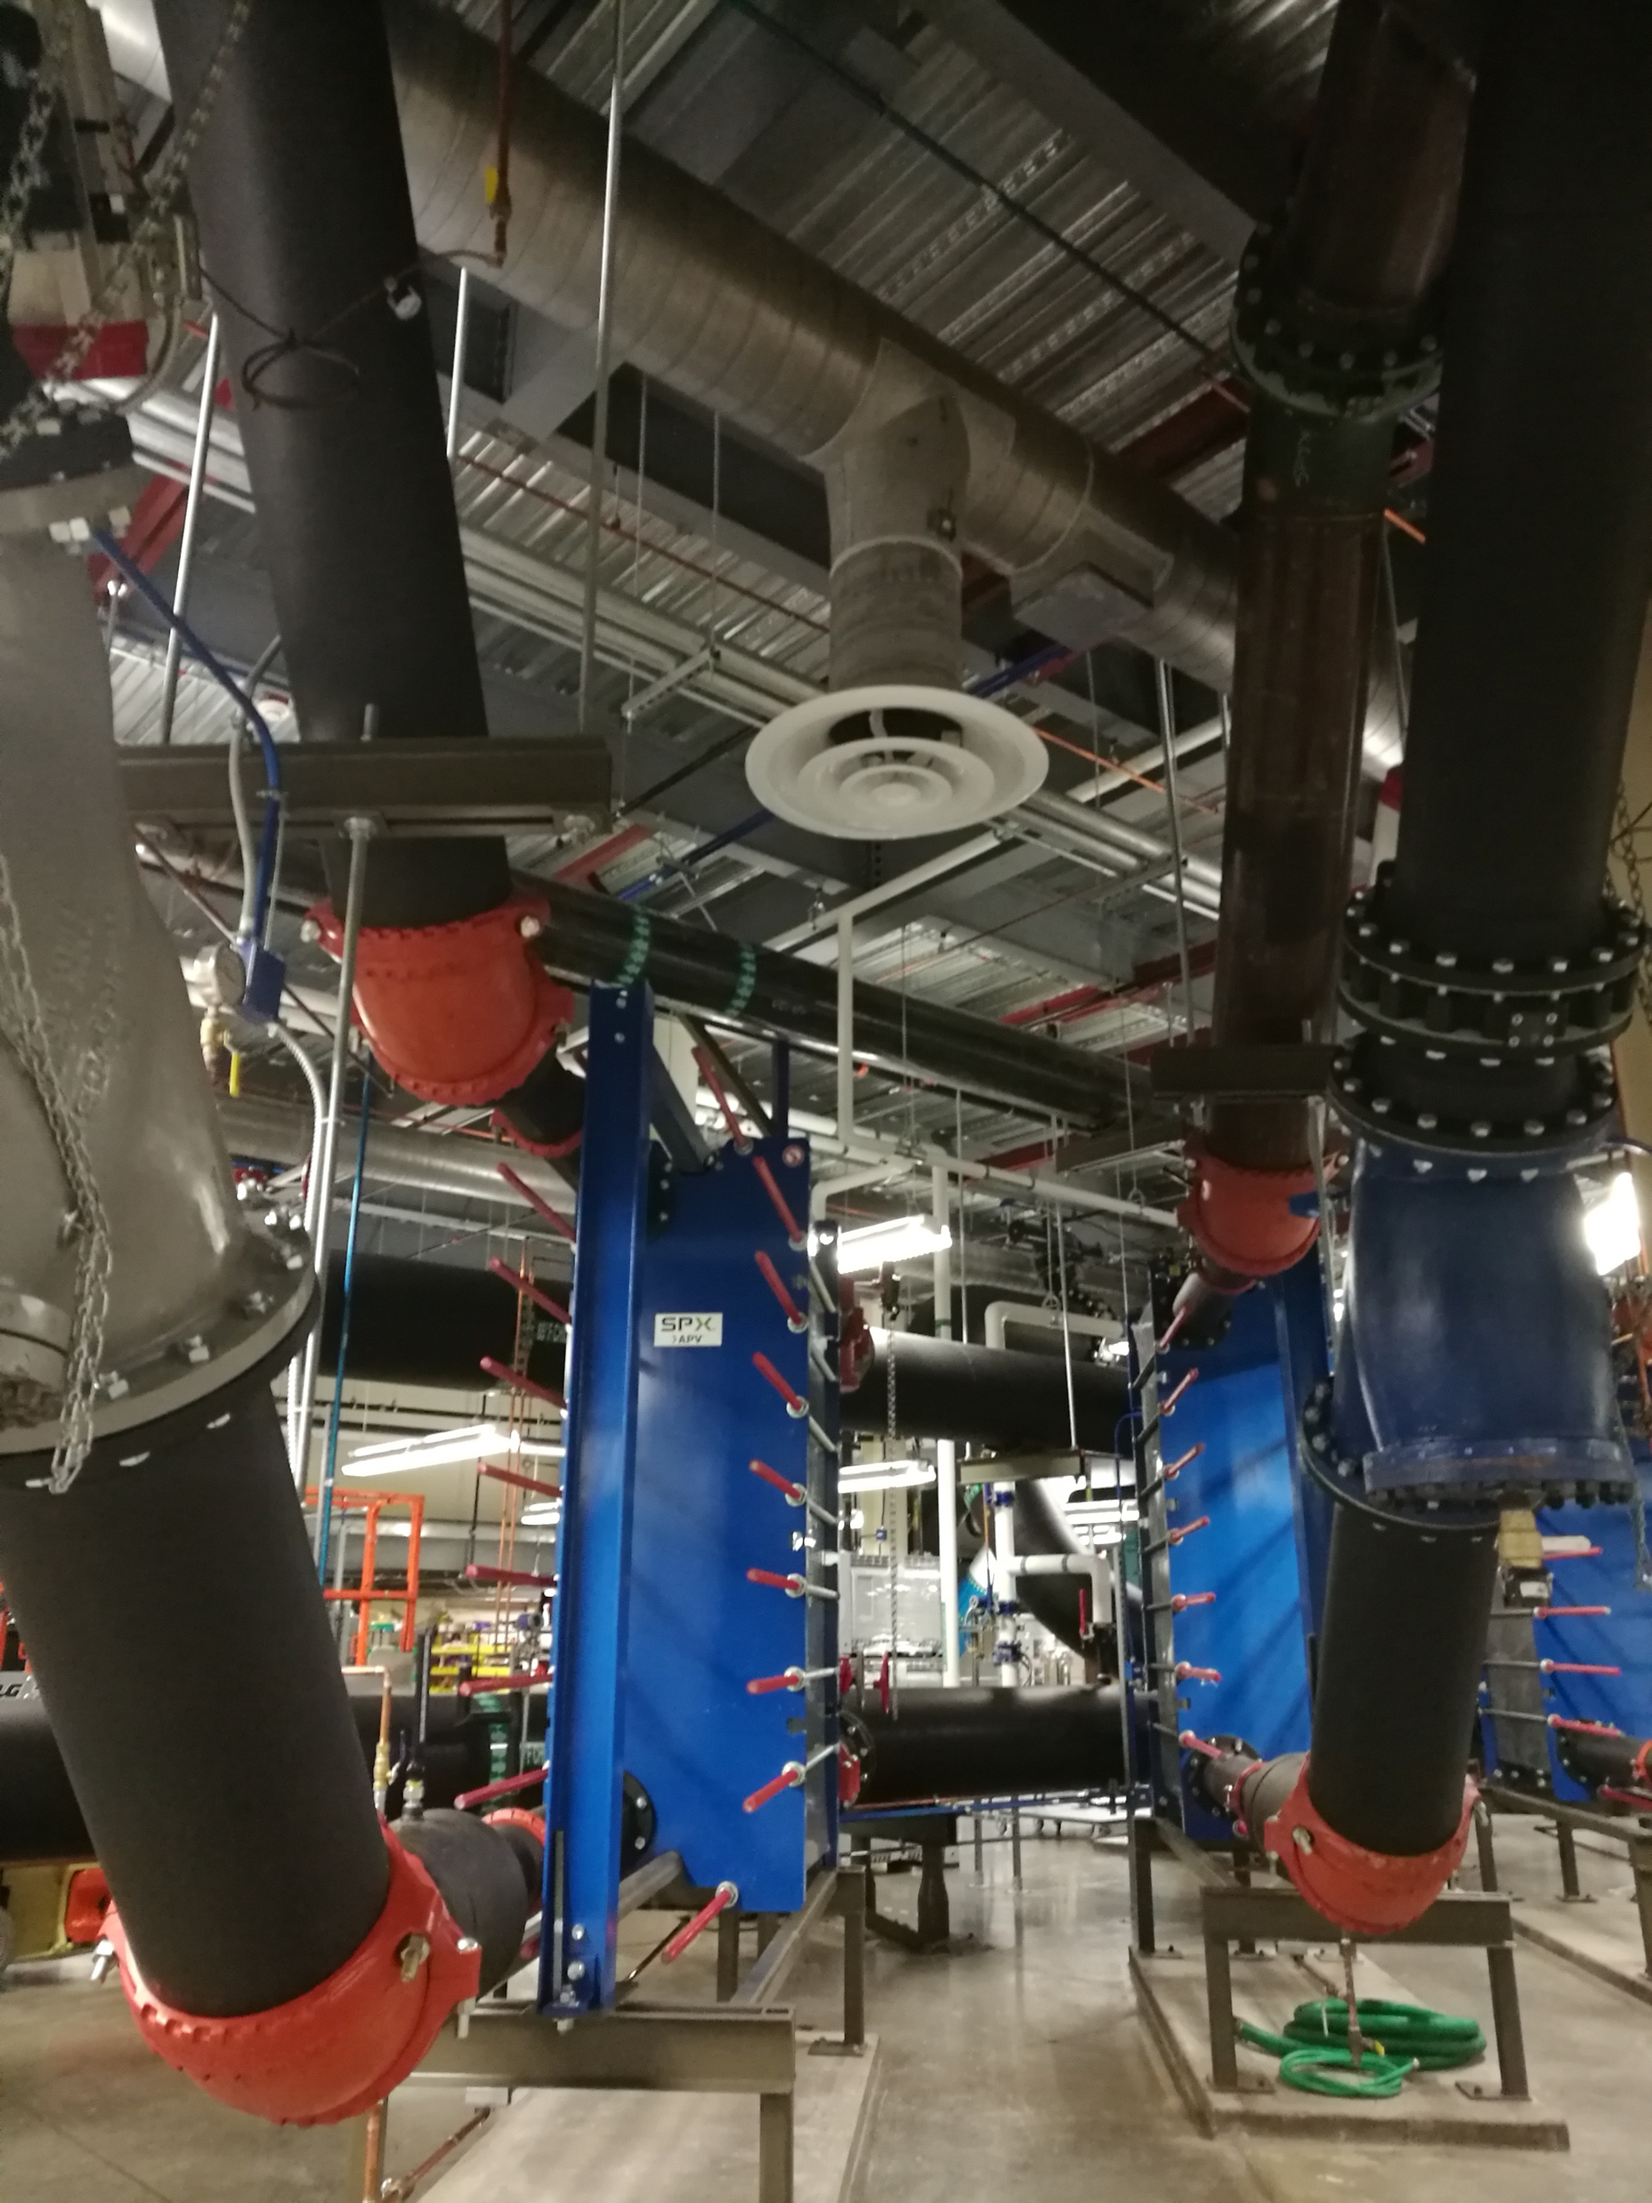
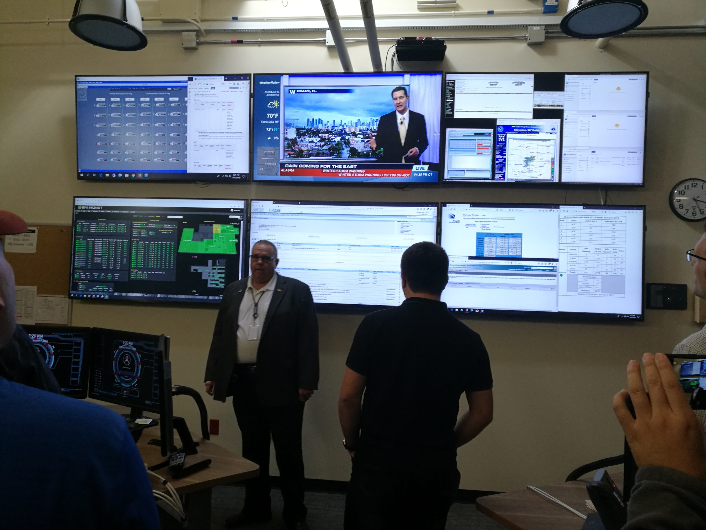
NCAR Cheyenne Supercomputer
Computing
Units
Storage
Units
Cooling System
Monitor
Room

Slide 23
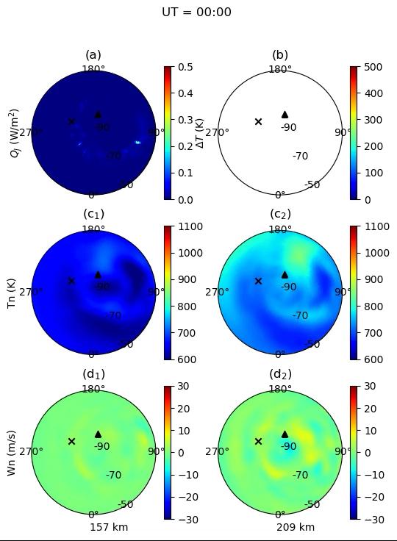
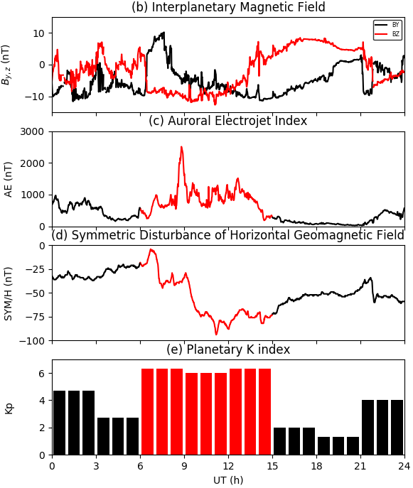
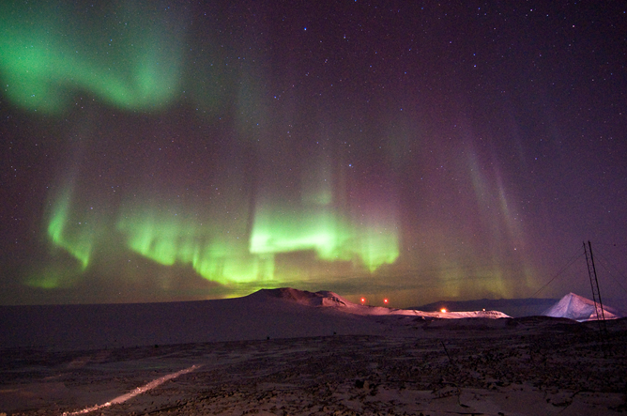
TIEGCM Simulation of
Space Storm
by Zhibin Yu

Slide 24


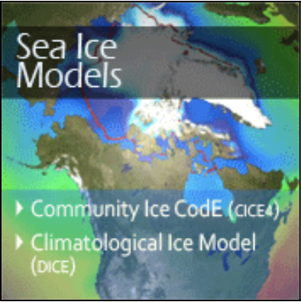



CESM (The Community Earth System model)
Fully-coupled, global climate model that provides state-of-the-art computer simulations of the Earth's past, present, and future climate states.
http://www.cesm.ucar.edu/models/cesm1.2/

Slide 25
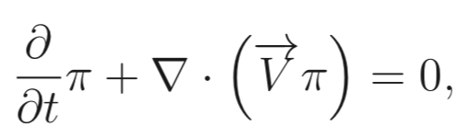
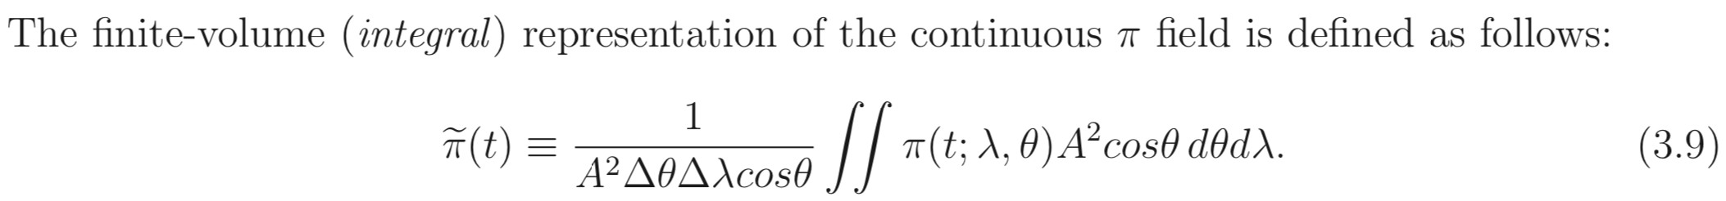
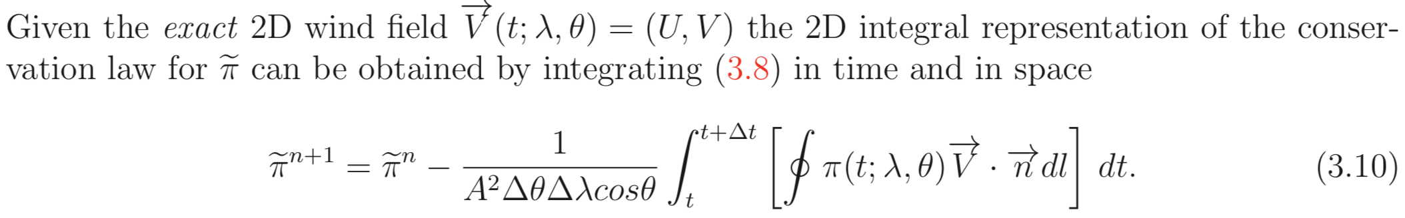
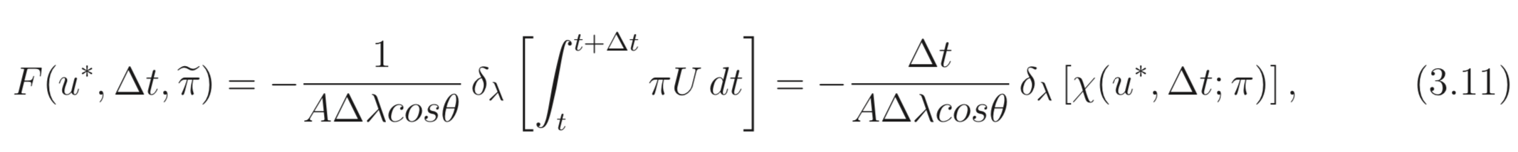
Finite Volume Method
Mass conservation:
Convergence of Flux
1D transport of flux
Flux Term
Flux Term
DescriptionofCAM5

Slide 26
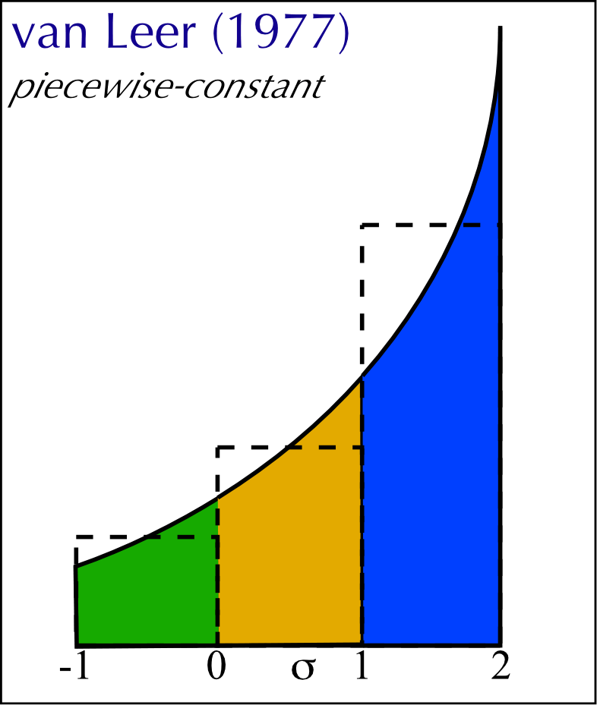
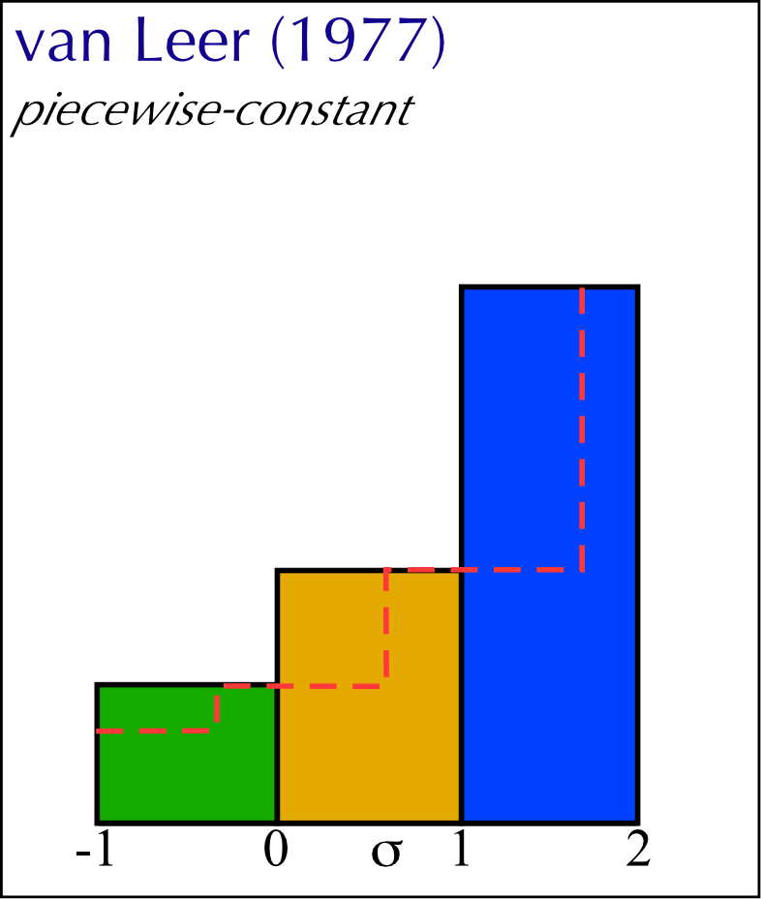
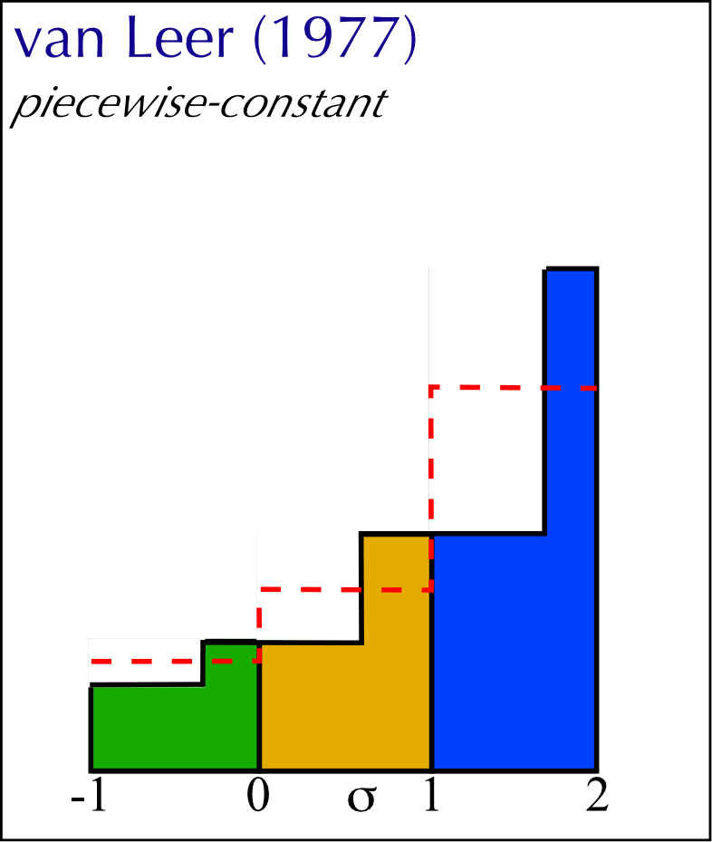
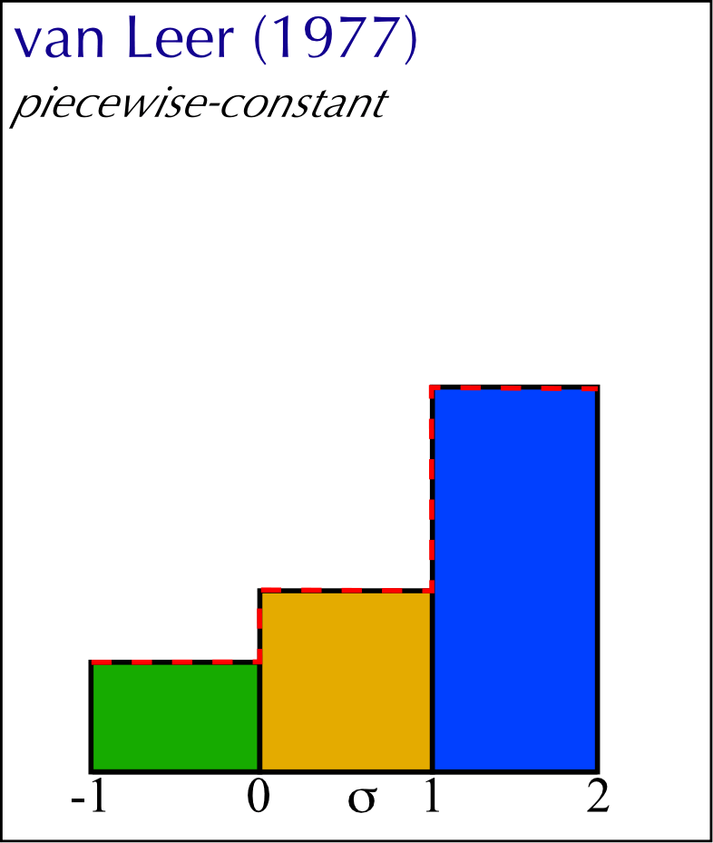
Finite Volume Method
Key issue: estimate fluxes coming in and out of the grid cell
Step 1 –
identify grid zone averages…
X coordinate is Courant number σ
Grid box runs from [0-to-1]•∆x
Step 2 –
look at distribution before and after advection takes place
Step 3 -
Compute new grid zone averages.
Step 4 -
The averages are the function here (for piecewise constant)
These are the initial values for the next time step.
Upstream – piecewise constant
Credit: ATMOS 502, UUC

Slide 27
van Leer (1977)
New value from integrating under piecewise constant function at time t that will be in the grid zone [0,∆x] at t+∆t.
Piecewise constant in each zone, so:
Grid-point value f(j) represents the average of the function over the grid cell (see Durran, §1.3.1, p. 27)
Credit: ATMOS 502, UUC

Slide 28
van Leer (1977)
van Leer notation ...
Fluxes …
note ∆t is already included in (is part of) the fluxes.
Coding:
Credit: ATMOS 502, UUC
Notes:
ON TO PIECEWISE LINEAR

Slide 29
Greater accuracy: Piecewise linear
Our general update formula:
Piecewise constant
Piecewise linear
Includes:
Zone average
Average slope
Constant – why?
Credit: ATMOS 502, UUC

Slide 30
Piecewise linear & beyond
Van Leer piecewise linear: Scheme I
slopes in zones.
- can be evaluated many ways.
scheme 1: centered differences
Like piecewise-constant: fluxes from zone averages.
Credit: ATMOS 502, UUC

Slide 31
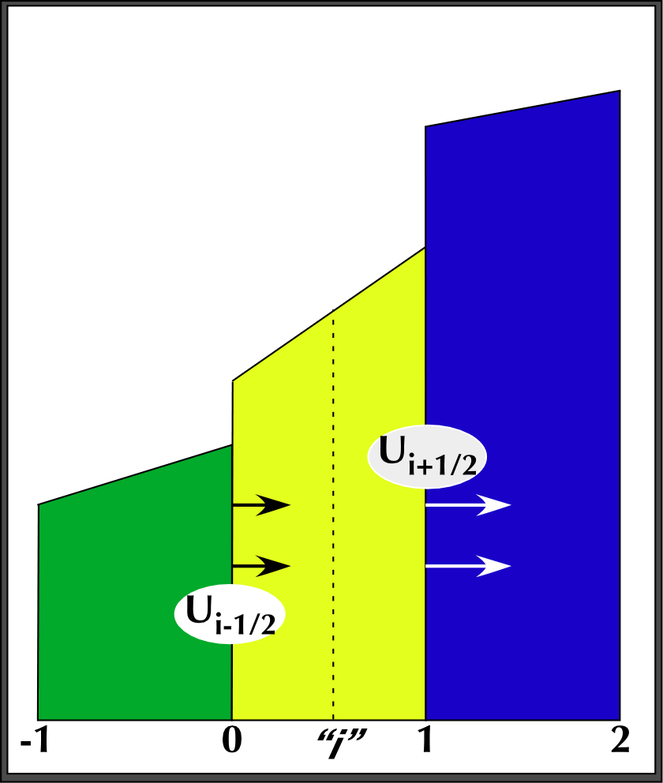
Piecewise linear form
Fluxes
integrate under function at time t that will be in zone [0,∆x] at t+∆t.
Grid zone boundary velocities (C-grid) shown
Credit: ATMOS 502, UUC

Slide 32
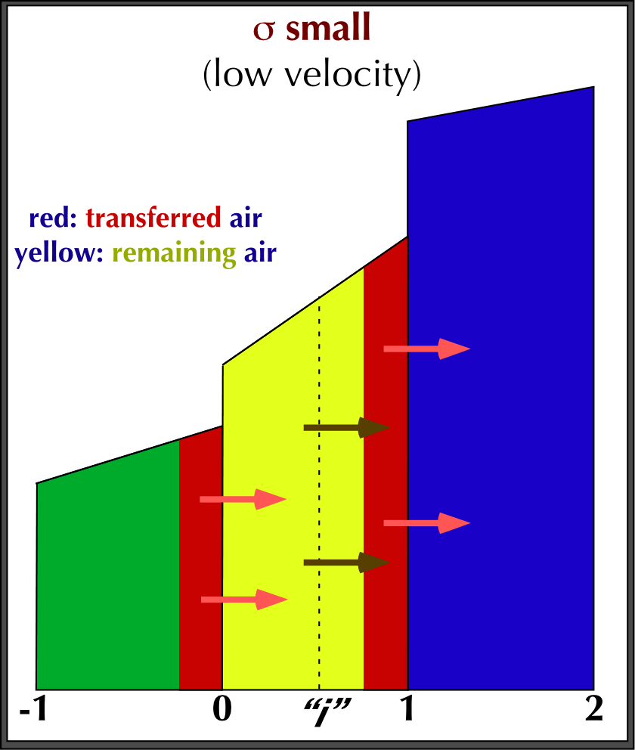
Piecewise linear form
Fluxes
Small σ: area in red transferred; yellow remains in the zone [0,∆x]
Credit: ATMOS 502, UUC

Slide 33
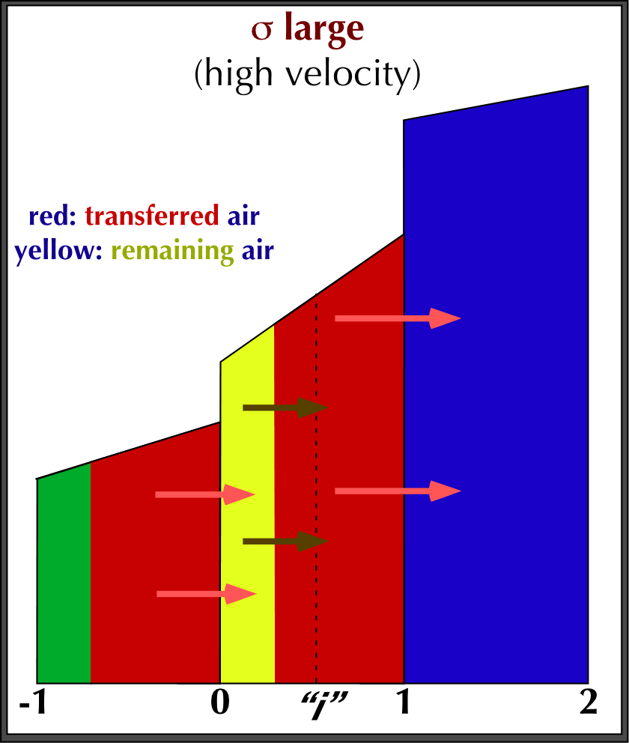
Piecewise linear form
Fluxes
High σ: area in red transferred; yellow remains in the zone [0,∆x]
Credit: ATMOS 502, UUC

Slide 34
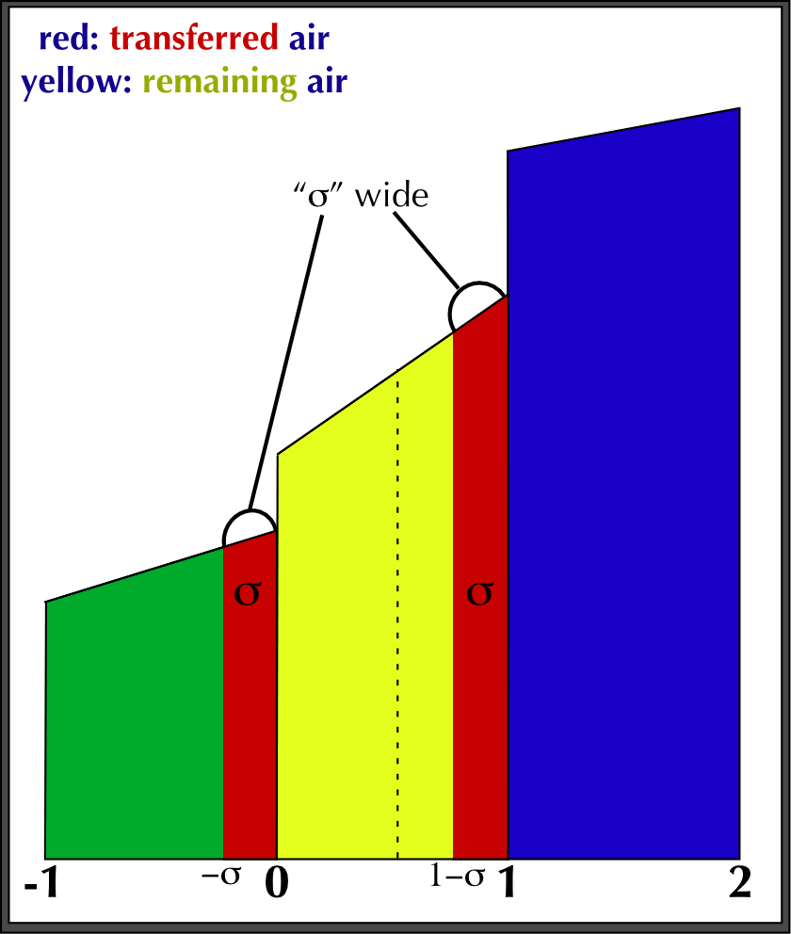
van Leer, integration
Integration bounds
Current area [0,1-σ] remains in zone.
Upstream area [-σ,0] is transferred into the zone [0,1].
Local function
is independently determined for each grid zone.
Credit: ATMOS 502, UUC

Slide 35
Implementing Piecewise Linear
Handling PL inside advect1d:
In the x-advect or z-advect step: for the x-direction, prepare 1D arrays of a row of theta^{n} and u^{n} as input to your advect1D.
Inside advect1d, you compute Courant number, slopes and fluxes:
Then you can do the integration, still in the 1-D advection code:
Credit: ATMOS 502, UUC

Slide 36
PL: monotonic slope limiter
Simple centered differences
In English:
This is average slope in the grid zone
Not monotonic
monotonic slope form
This is known as the “minmod” flux limiter (see Durran, §5.5.2, p. 230)
Credit: ATMOS 502, UUC

Slide 37
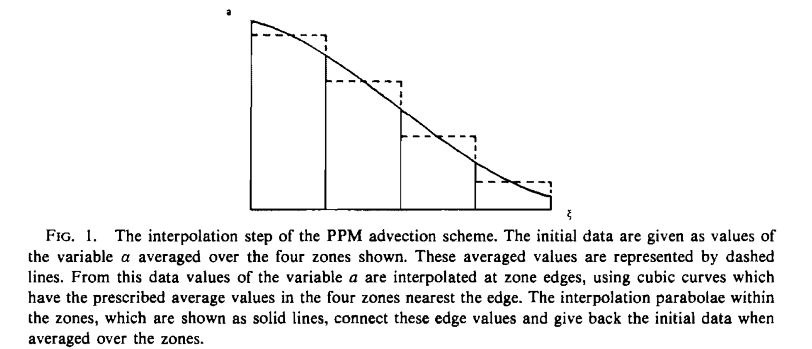
Piecewise Parabolic Method (PPM) Adopted in CESM
Colella and Woodward, 1984
PPM (second-order polynomial within the volume.
Mass conserving, monotonicity preserving, and high-order accuracy
Good balance between computational efficiency and accuracy.

Slide 38

Earth (Terrestrial) Weather
A Compset of CESM (Community Earth System Model)
Currently Running at Palmetto, Clemson
Liu et al., GRL, 2015
Notes:
In the lower atmosphere, the prominent feature is the weather pattern moving along. They generate waves, but waves are too small to be seen.

Slide 39
Project Proposal
Background, problem, how (roughly)?
Thursday:
Tedi, Haonan, Jintai, Weijia
Next Tuesday:
Komal, Andrew, Alex, Brynna, Will

